Slide 1

communication
Shifting gears: from crunching numbers to crafting stories

Slide 2

The problem: Toll-booth syndrome
For students, writing is not communication; rather, it is a demonstration – that work has been done, that thinking has happened.
Wrong from the start. Writing is not something that happens after the research and thinking process. It is the thinking process.
(paraphrased from George Gopen)

Slide 3
To drive home the point...
In the professional world, it matters not how much work the writer has done; it matters only that the reader actually gets delivery of precisely that which the writer had intended to send. Communication in that professional world requires that the 40 cents’ worth of thought actually be received by the reader—not just that it be jettisoned into the air and onto the page by the writer.
(paraphrased from George Gopen)

Slide 4
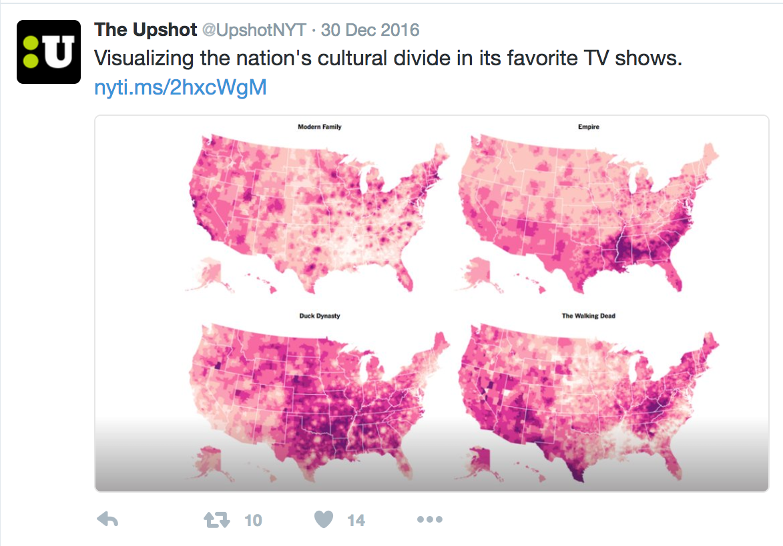
The Upshot
1. Visit @UpshotNYT at Twitter
2. Browse the tweets
3. Pick a compelling story and answer the following questions:
- What is the story behind the analysis? - What analysis is integrated into the story?
- What makes the story interesting to you?
- How does the analysis add to this interestingness?

Slide 5
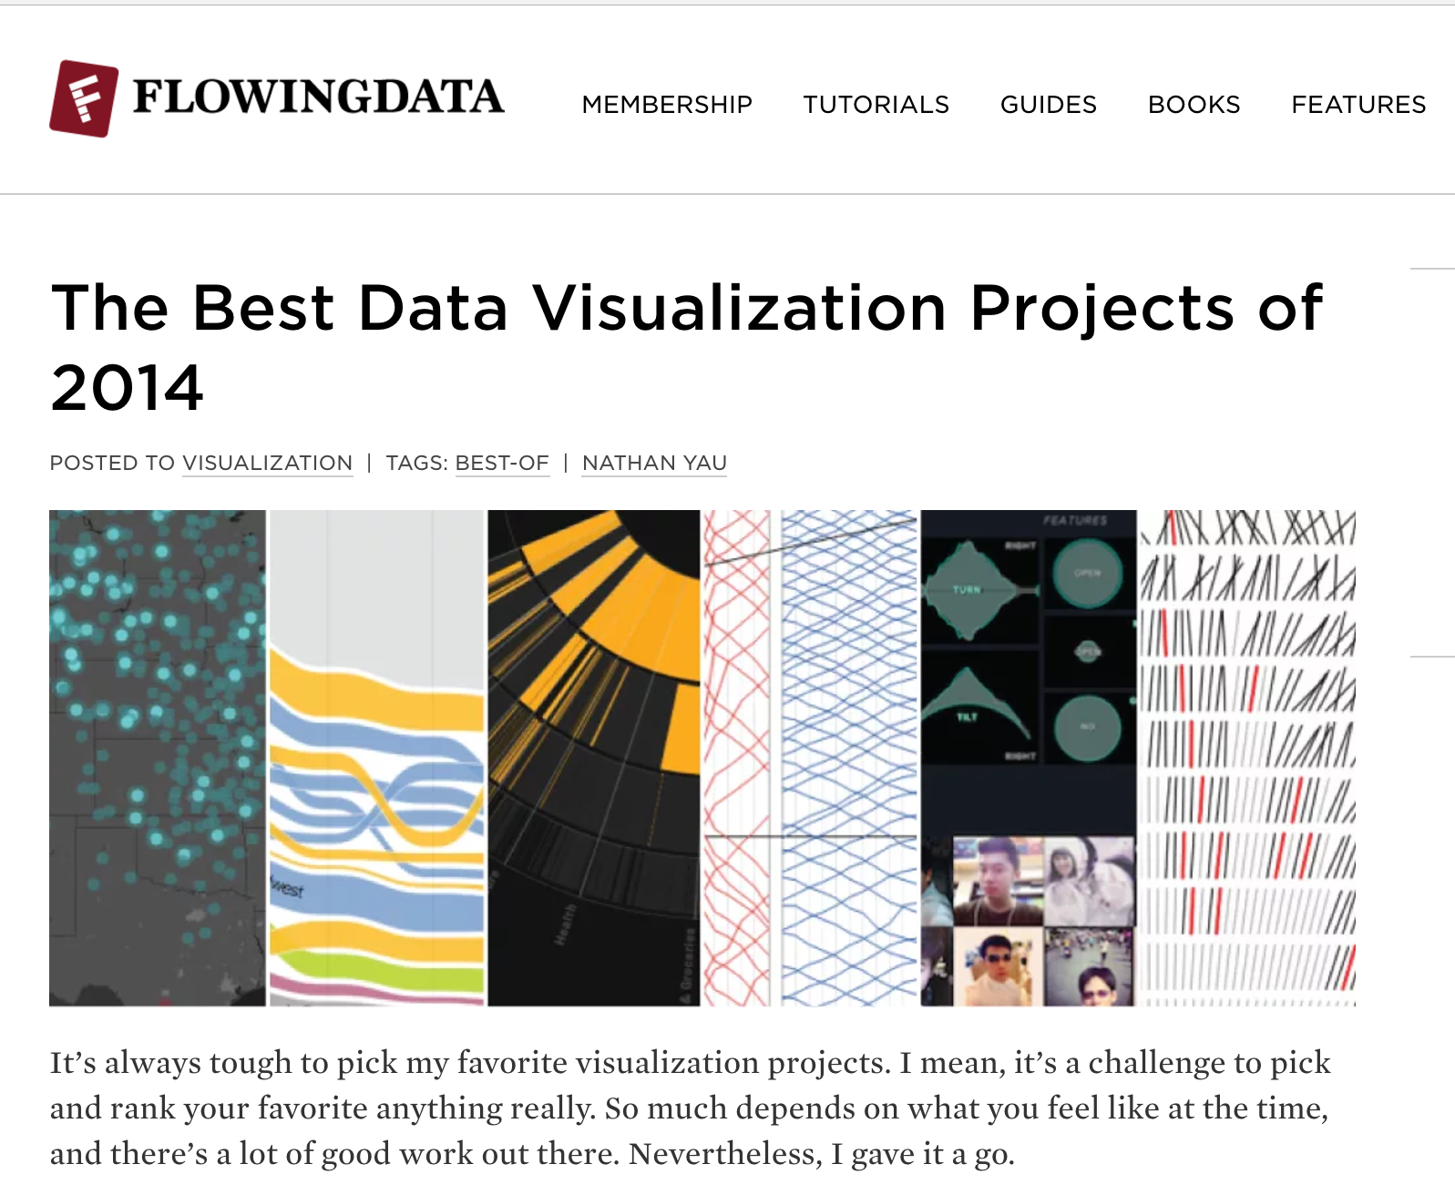
Flowingdata.com
1. Visit flowingdata.com
2. Browse the gallery
3. Pick a compelling visualisation and answer the following questions:
- What makes the visualisation a powerful one?
- How would you improve it?

Slide 6
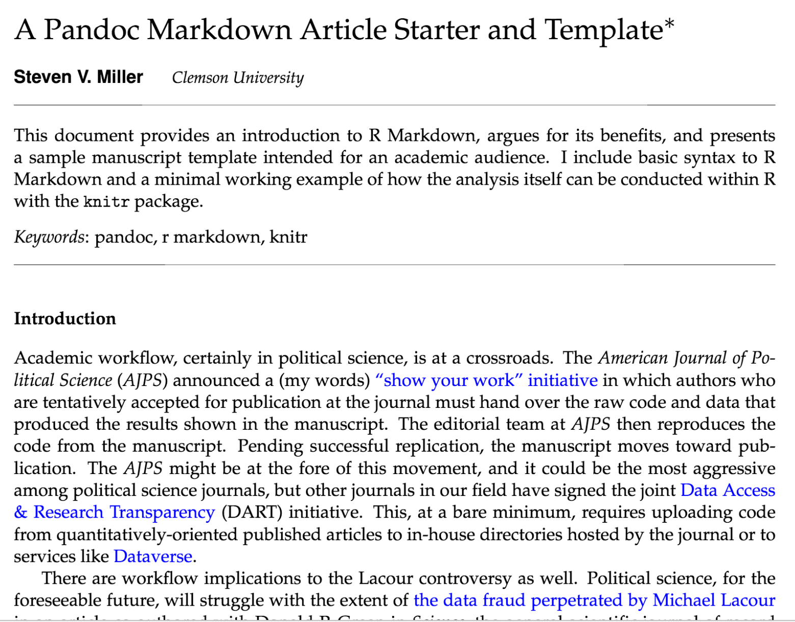
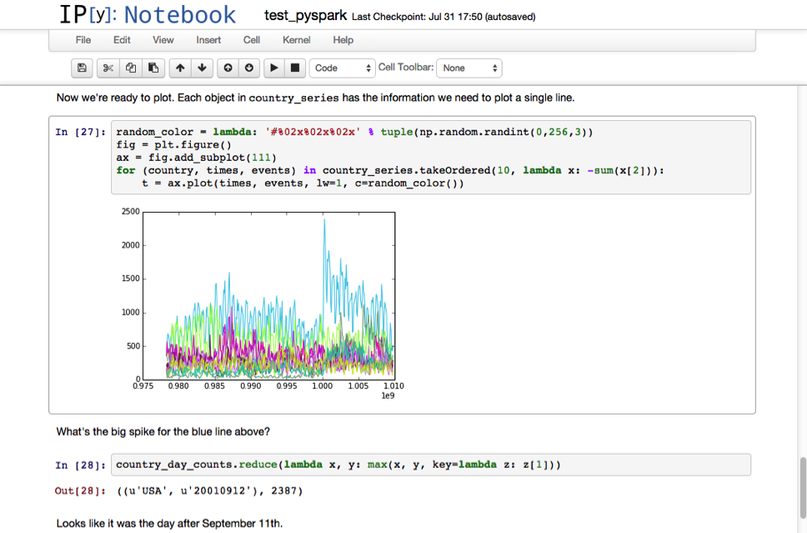
RMarkdown or ipython notebook

Slide 7
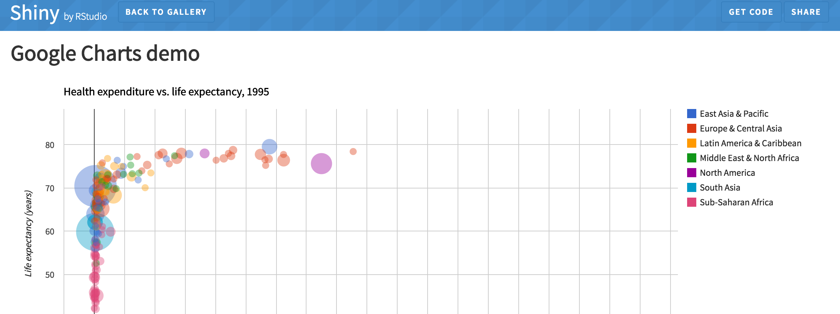
Shiny.rstudio.com

Slide 8
summary
Communicating analyses can range from journalistic (story-oriented) to technical (eg. Explaining approaches to a problem)
For both, good communications habits are important. Avoid the toll-booth syndrome with existing tools!

